Slide 1
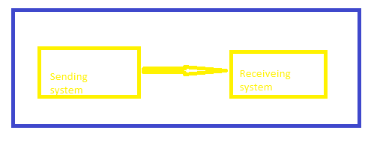
JMS (Java massaging service)
Service Integration Bus (SIB) : JMS provider
To grasp the concept of a service integration bus (SIB) its beneficial to first understand how data transmission occurs without utilization a service Integration Bus
In this very simple diagram the sending
services sends data to the receiving service,
like an Emil or an SMS message.
2. While this works , it can lead to problems
a. If the receiving service is down or too
Busy the sending service might not move
on the next task or keep trying to send the data, wasting resources.
b. A services Integration Bus solves this issues

Slide 2
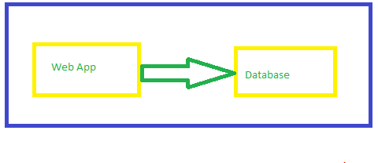
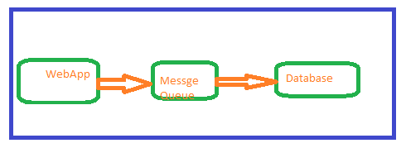
JMS (Java massaging service) Queue
Service Integration Bus (SIB) : JMS provider
1. Imagine you have web based application that writes to a
database during peak time, million of write requests
might cause significant latency
2. In the worst-case scenario, this could
lead to webs app loading endlessly,
failing to load, returning timeout error,
Or displaying various errors not good.
3. Enter the message Queue?
4. The web application can publish messag to queue ,
and the database can them consume there message
5. This is an example of the publish/subscr ibe (pub/sub)
architecture, where the web app publishes message to the
Queue , and the database subscribes to it.

Slide 3
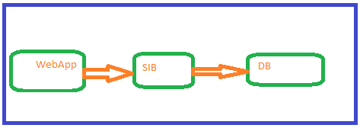
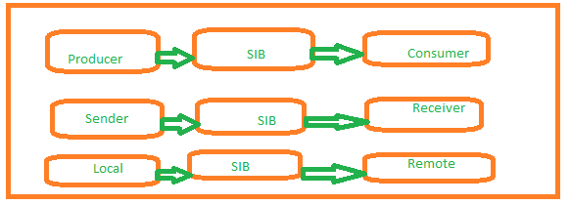
JMS (Java massaging service) SIB
Service Integration Bus (SIB) : JMS provider
A service Integration Bus act as broker or proxy between
the sending and receiving services
This setup prevent the sending service form
Getting stuck if the receiving service is unavailable,
Instead of repeatedly trying to send the data
The sending service transmit it to the SIB and move on (fire and forget)
This approached allows for asynchronous data transmission
You may encounter different terms user for the service
in a messaging hierarchy

Slide 4
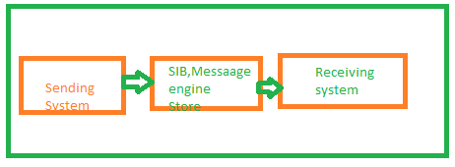
JMS (Java massaging service) Store
Service Integration Bus (SIB) : JMS provider
A services Integration Bus consist of one or more
Websphere Application Servers, which can be part
Of a static or dynamic cluster, or IBM MQ server
These servers knows as bus members,
Include a messaging engine component used to
Send and receive messages
The messaging engine store messages in s message
Store, where the remain until the consume application
Is ready to receive the.
The message can be store can be a file on the server
or a database

Slide 5
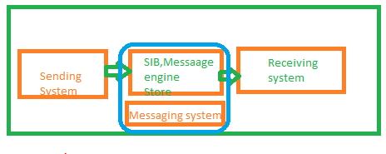
JMS (Java massaging service) SIB High Availability
Service Integration Bus (SIB) : JMS provider
Given the SIB’s crucial role in message deliver,
It is essential to ensure its high availability.
Ideally, the SIB should not experience any
downtime, to achieve this ,it’s recommended
to setup a cluster of application servers as SIB
Members.
This way, if one cluster member goes down,
the other member can continue processing messages.

Slide 6
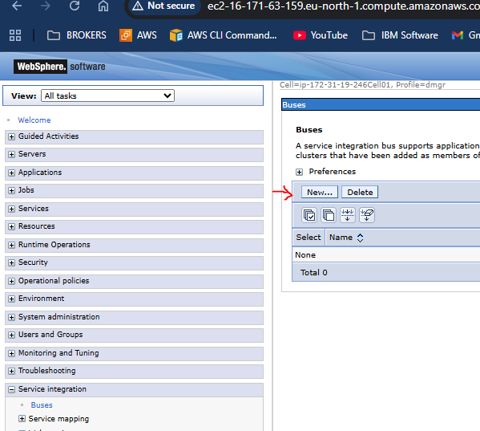
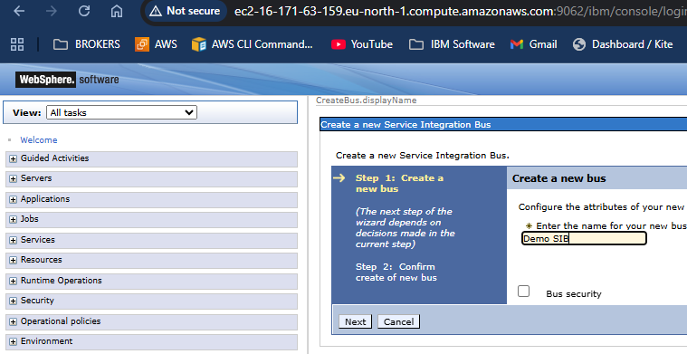
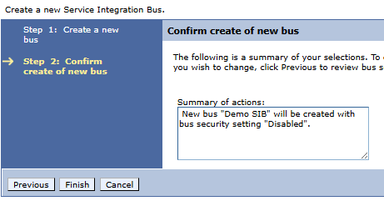
JMS (Java massaging service) Configure Services Integration Bus (SIB)
Create Service Integration Bus
In the Websphere Admin console,
Service Integration and select Buses
Select new
Give the SIB a name and select next
For the remaining prompts select next and the
finish

Slide 7
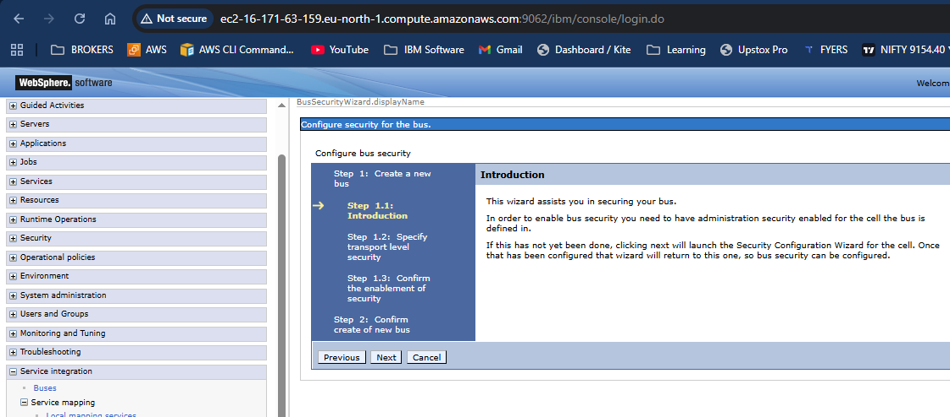
JMS (Java massaging service)
Services Integration Bus : JMS Provide

Slide 8
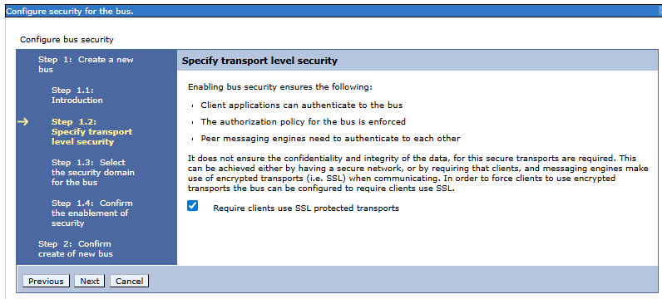
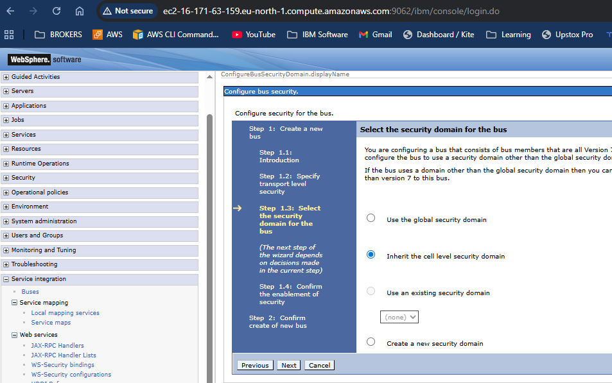
JMS (Java massaging service) JMS Provider

Slide 9
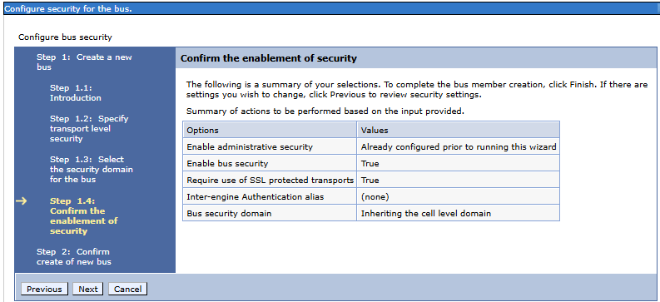
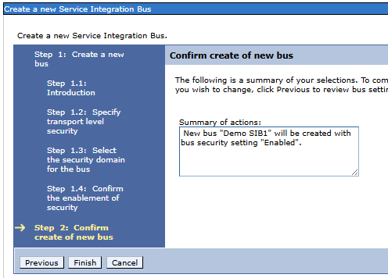
JMS (Java massaging service) JMS Provider
Service Integration Bus (SIB): JMS Provider

Slide 10
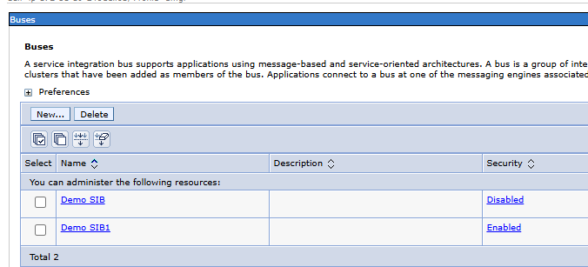
JMS (Java massaging service) JMS Provider

Slide 11
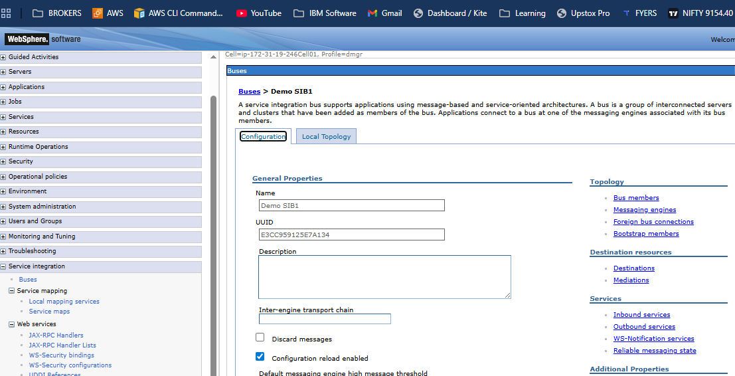
JMS (Java massaging service) Add Bus member
Services Integration Bus (SIB)
Add Bus members
An Application server, cluster, or MQ server that
a member of service Integration Bus is known as a bus
member
In the left pane of the web console
Expand service integration and select Buses
Select the Services integration Bus.
Select Bus member
Select Add
Select a server, cluster, or MQ server and select next.

Slide 12
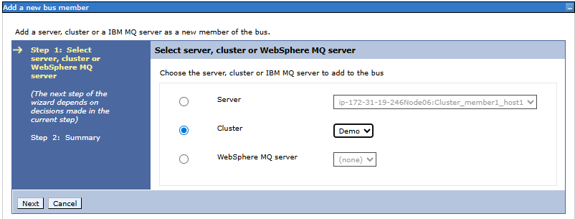
JMS (Java massaging service) Add Bus member
Select Members, in this example cluster selected.
If you selected cluster , you will be prompted to select a messing engine policy, in this example , scalability with High availability
The scalability with high availability selection ensure that each application server in the cluster has a messaging engine for failover support.

Slide 13
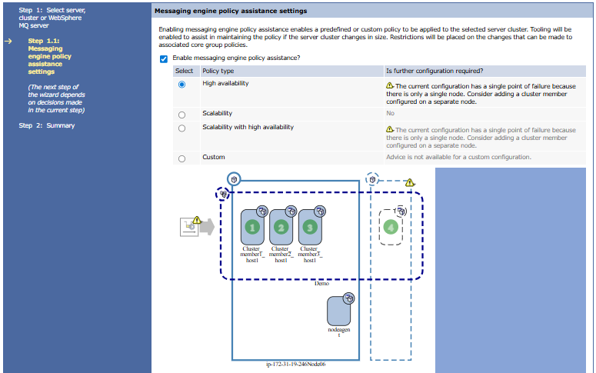

Slide 14
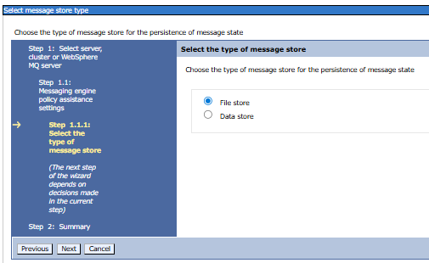
JMS (Java massaging service) Configure Database
Configure database
Click on both store one by one and configure

Slide 15
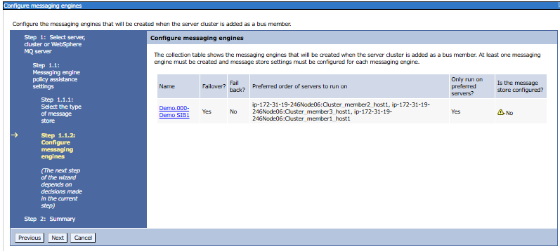
JMS (Java massaging service) Configure Database

Slide 16
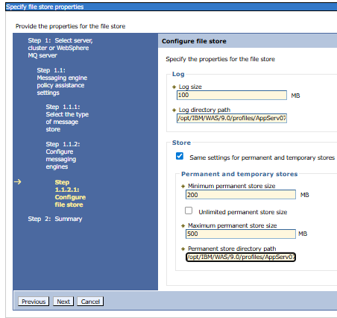
JMS (Java massaging service) Configure Database

Slide 17
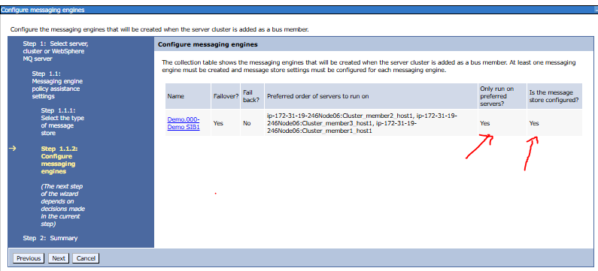
JMS (Java massaging service) Configure Database

Slide 18
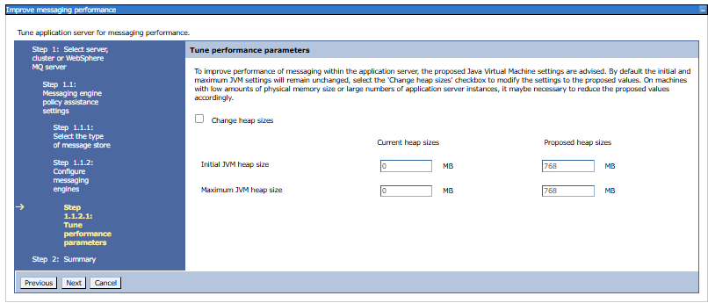
JMS (Java massaging service) Configure Database

Slide 19
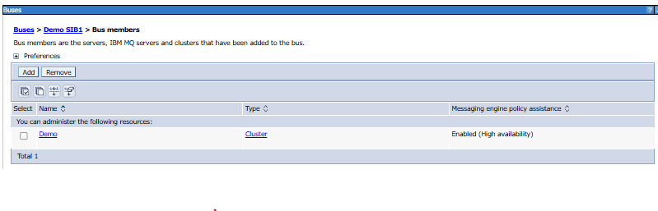
JMS (Java massaging service) Configure Database

Slide 20
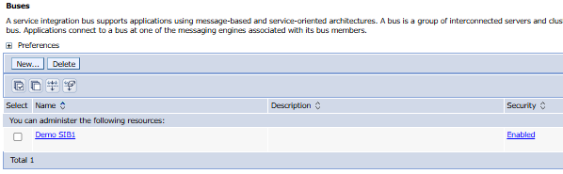
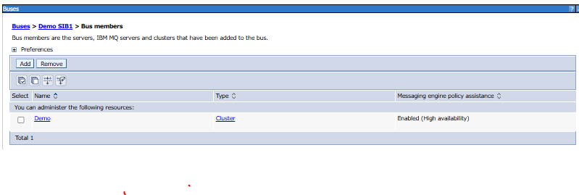
JMS (Java massaging service) Configure Database

